Slide 1
Visualization and prediction of us visa application by using machine learning techniques
Presented by
Joshua Sackey and Blaise Ayirizia
University of Texas, El Paso
May 6, 2024

Slide 2
Agenda
Introduction
Motivation and Objectives
Main Content
Models
Data Background
Exploratory Data Analysis
Cleaning and Preparing the data
Results
Conclusion

Slide 3

INTRODUCTION

Slide 4
A permanent labor certification issued by the Department of Labor (DOL) allows an employer to hire a foreign worker to work permanently in the United States.
Before the U.S. employer can submit an immigration petition to the Department of Homeland Security's U.S. Citizenship and Immigration Services (USCIS), the employer must obtain a certified labor certification application from the DOL’s Employment and Training Administration (ETA).

Slide 5
Motivation and objective
Motivation:
To use machine learning techniques to tell if a US visa applicant gets certified or denied.
Objectives:
In this study, the focus was to visualize the US visa applications dataset
To predict US Visa decisions based on some features by using three different machine learning techniques.

Slide 6

Main content​

Slide 7
models
Logistic Regression
Random Forest
KNN

Slide 8
Data set
The original dataset contains 374,362 observations, characterized by the same 154 labeled variables, each of them representing “Certified", “Denied", “Certified-Expired" or “Withdrawn" decisions.
Binary classification problem.
The explanatory features included information on the employer information, job information, class of admission, country of citizen, among others.

Slide 9
Data set continued
The information set contains 356,168 observations, about which 93% of the applicants got certified and 7% denied.
Class imbalance problem.
Source of data set: Kaggle

Slide 10

Exploratory data analysis
Descriptive statistics and visualizations are used to explore the distribution of variables and identify patterns within the data

Slide 11
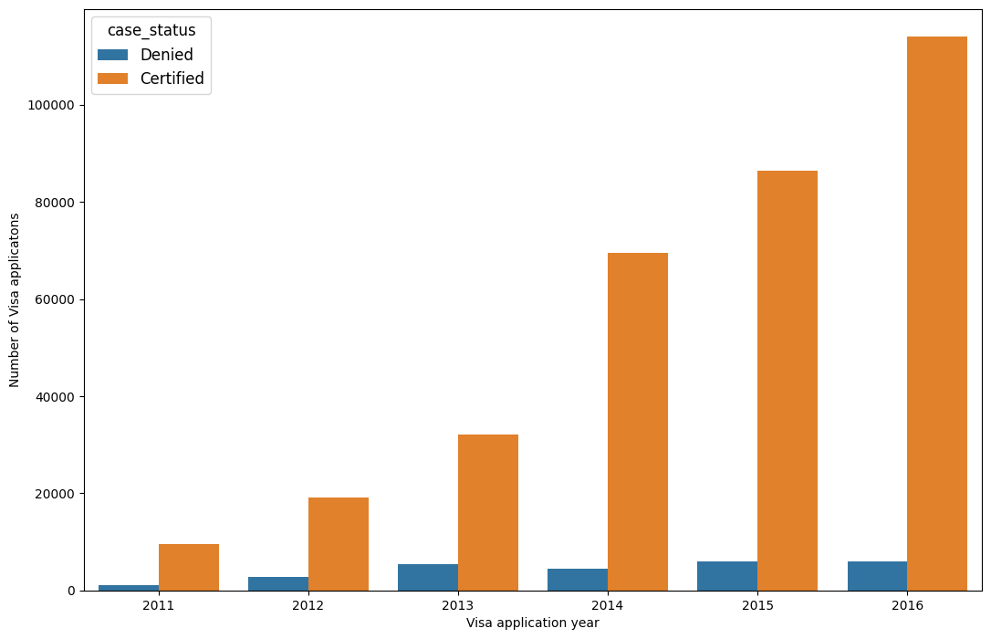
Figure 1: Plot of Certified vs Denied Based on Years

Slide 12
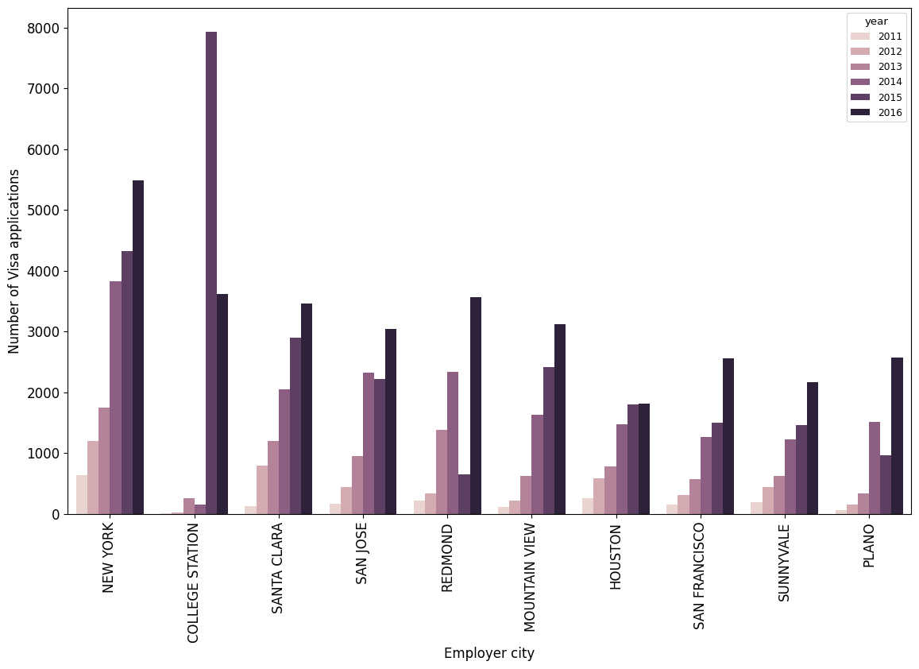
Figure 2: Employer City Vs Number of Visa Application

Slide 13
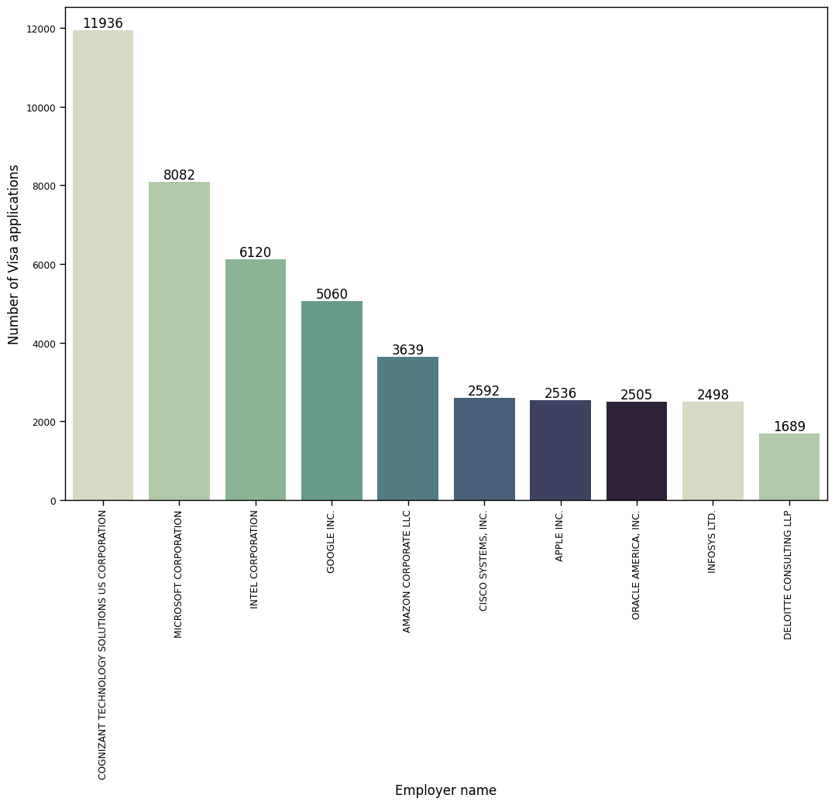
Figure 3: Employers vs Visas Certified

Slide 14
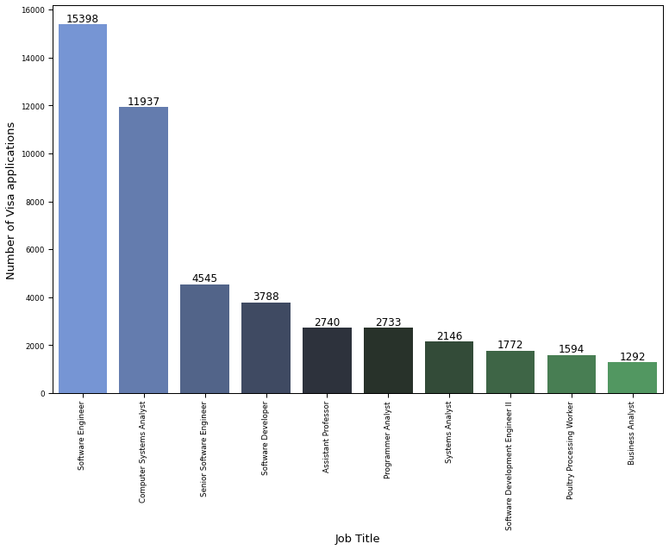
Figure 4: Job Title vs Number of Visa Application

Slide 15
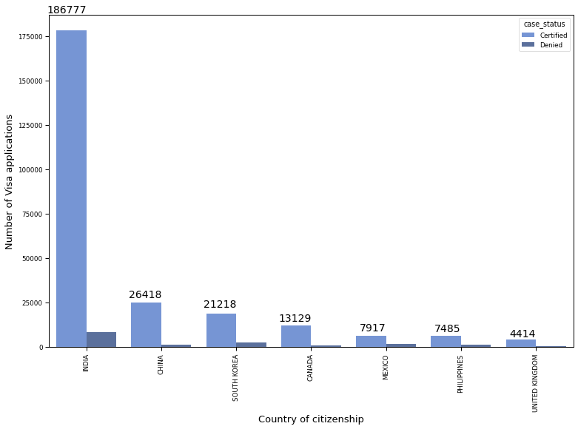
Figure 5: Country of Citizenship vs Number of Visa Application

Slide 16
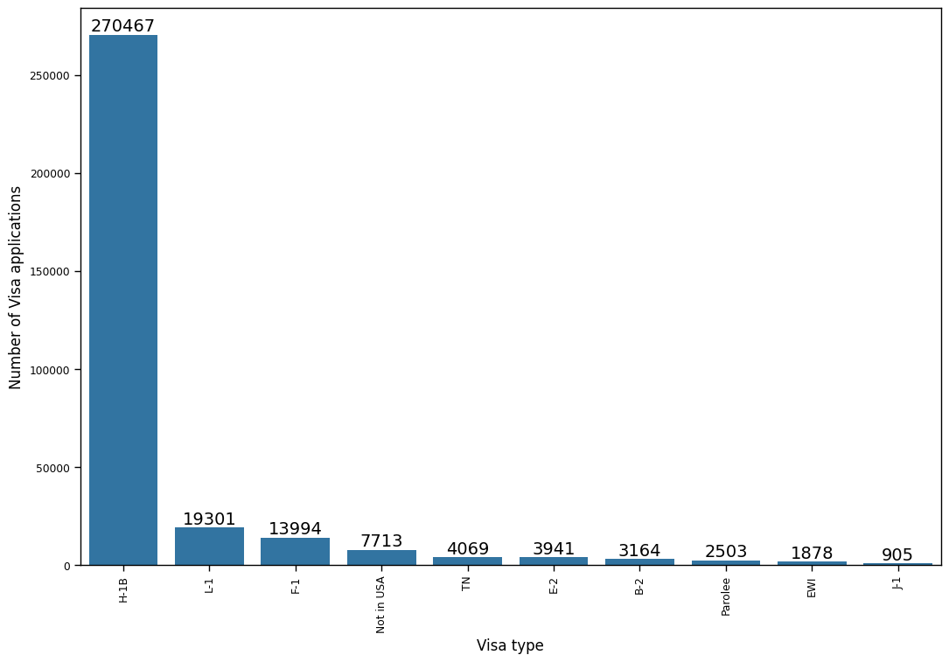
Figure 6: Visa Type Vs Number of Visa Applications

Slide 17
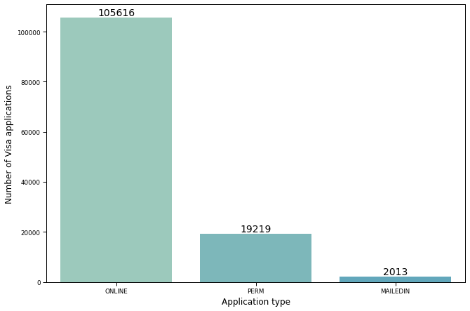
Figure 7: Application Type vs Number of Visa Application

Slide 18
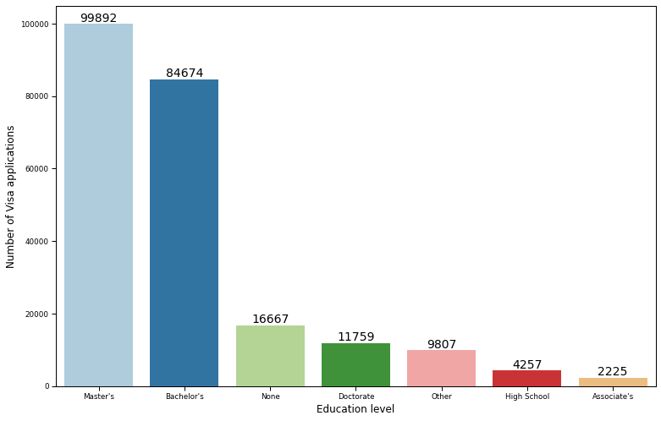
Figure 8: Education Level Vs Number of Visa Applications

Slide 19
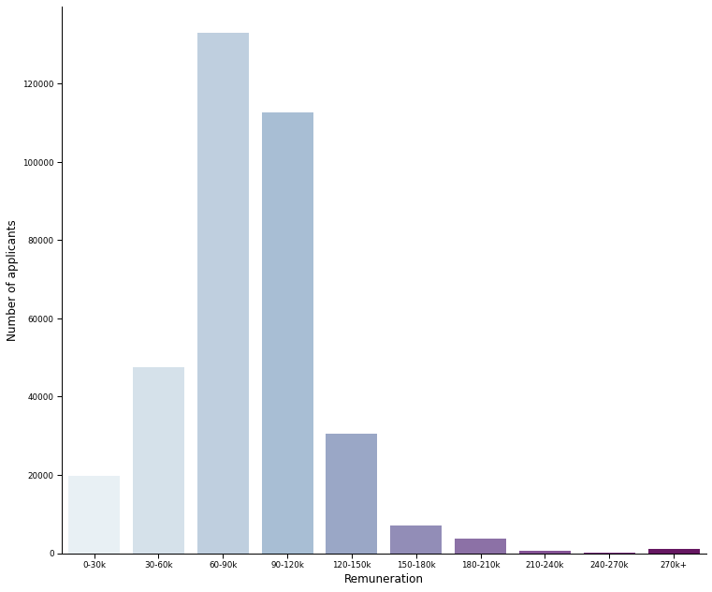
Figure 9: Renumeration vs Number of Visa Application

Slide 20
Data cleaning and preparation
The data now has 356,168 applications described by 154 attributes.
Attributes that had at least 60 percent missing values were removed.
Missing values in the remaining parameters were imputed by replacing the numeric missing column values with column means and the character and factor with missing column values with column mode.
Due to the large number of visa applicants and less computer power, we focus our analysis on the 26,418 visa applicants from China which is still a large number.​

Slide 21
Data cleaning and preparation
Among these applicants, the distribution of the response feature (case status) were 26418 Certified and 1487 Denied applications which is obviously a class imbalance problem.
Randomly partition the data sets into the training sample and test sample in 2:1 ratio.
Re-adjust the class distribution of the data set by performing Random Over-Sampling (ROSE)

Slide 22
results

Slide 23
Accuracies and mse’S of the logistic regression model
TYPE | ACCURACY | MSE
Imbalance | 0.94 | 0.057
Balance | 0.74 | 0.26

Slide 24
Accuracies and mse’S of the K Nearest Neighbors model
TYPE | ACCURACY | MSE
Imbalance | 0.95 | 0.0523
Balance | 0.87 | 0.1326

Slide 25
Accuracies and mse’S of the random forest model
TYPE | ACCURACY | MSE
Imbalance | 0.95 | 0.0478
Balance | 0.95 | 0.0495

Slide 26
Results cont.
The top four (4) topmost important features are; the type of job, size of company, educational level, and the salary of employees are variables that predict certification or denial of permanent US Visa.

Slide 27
conclusion​

Slide 28
In this study, I visualized the US visa applications data set and predicted the visa decisions based on some important features by using three different machine learning techniques.
The Random Forest which is a tree-based model turned out to be the best and stable binary classifier as they properly create split directions, thus keeping only the efficient information.
From a foreign workers perspective, the profile of the selected top four (4) features from models would be key when choosing employers to work with.

Slide 29
Thank you

